Slide 1

Mini-Project Presentation
On
Blood Unity
DEPARTMENT OF COMPUTER ENGINEERING AND
APPLICATIONS
NOV 2023
Presented by :- Under the Supervision of :-
Kunika Agrawal Mrs. Ruchi Talwar
Raj Jakhad
Sourabh Vanshkar

Slide 2
Introduction
This project is designed for successful completion of project on blood bank management system
The basic building aim is to provide blood donation service to the city recently
This project aims at maintaining all the information pertaining to blood donors, different blood groups available in blood bank and help them manage in a better way

Slide 3
Objectives
Automate the complete operations of Blood Bank
Maintain thousand of Records
Searching Blood is very fast so they can find required details instantly
Easily Can get Donor Details and location
Blood Unity aims to simplify and sanitize the blood donation process, ensuring transparency, ease of access, and corruption-free blood bank management for a more effective and ethical healthcare system.

Slide 4
Problem Statement
Scarcity of Rare Blood Group
Unavailability of Blood During Emergency
Less Awareness among people about Blood Donation
Deaths due to lack of blood during operations

Slide 5
Abstract
Blood Unity is a transformative project dedicated to enhancing the transparency and efficiency of blood donation processes. With a focus on hassle-free access, corruption-free blood bank management, and innovative technology solutions, the project aims to create a more effective and ethically sound system for the benefit of donors and recipients alike.

Slide 6
Literature Review
The literature review explores existing studies and findings related to blood donation and management. It provides insights into the current state of the field, challenges faced, and solutions proposed by previous researchers. By analyzing this existing knowledge, the literature review sets the foundation for understanding the context, identifying gaps, and shaping the innovative approach taken by Blood Unity in its mission to enhance transparency and effectiveness in blood donation processes.

Slide 7
Methodology
HTML, CSS, JavaScript: The foundational trio for building interactive and visually appealing web applications.
MongoDB: Our choice for a scalable and flexible NoSQL database, providing a seamless way to manage data.
React: Empowering us with a powerful JavaScript library for building dynamic user interfaces, ensuring a seamless and responsive user experience.
Git Version Control: Streamlining collaborative development with robust version control, enabling efficient tracking and management of code changes

Slide 8
Working
User Registration : Donors and recipients can register on the website, providing essential information such as name, contact details, and blood type.
User Authentication : Implement secure user authentication methods to ensure the confidentiality and integrity of user data.
Donor Database: Maintain a comprehensive donor database, including details such as blood type, location, and donation history.
Appointment Scheduling: Allow donors to schedule appointments for blood donation, providing flexibility and reducing wait times.

Slide 9
System Architecture
User Registration: Users create accounts on the car selling website by providing necessary information
such as email, password, and contact details
Database:
Mongo DB for storing donor and recipient information.
Collections for user profiles, appointments, and other relevant data.
Authentication Service:
Manages user authentication and authorization.
Integrates with the application server to secure access to sensitive data

Slide 10
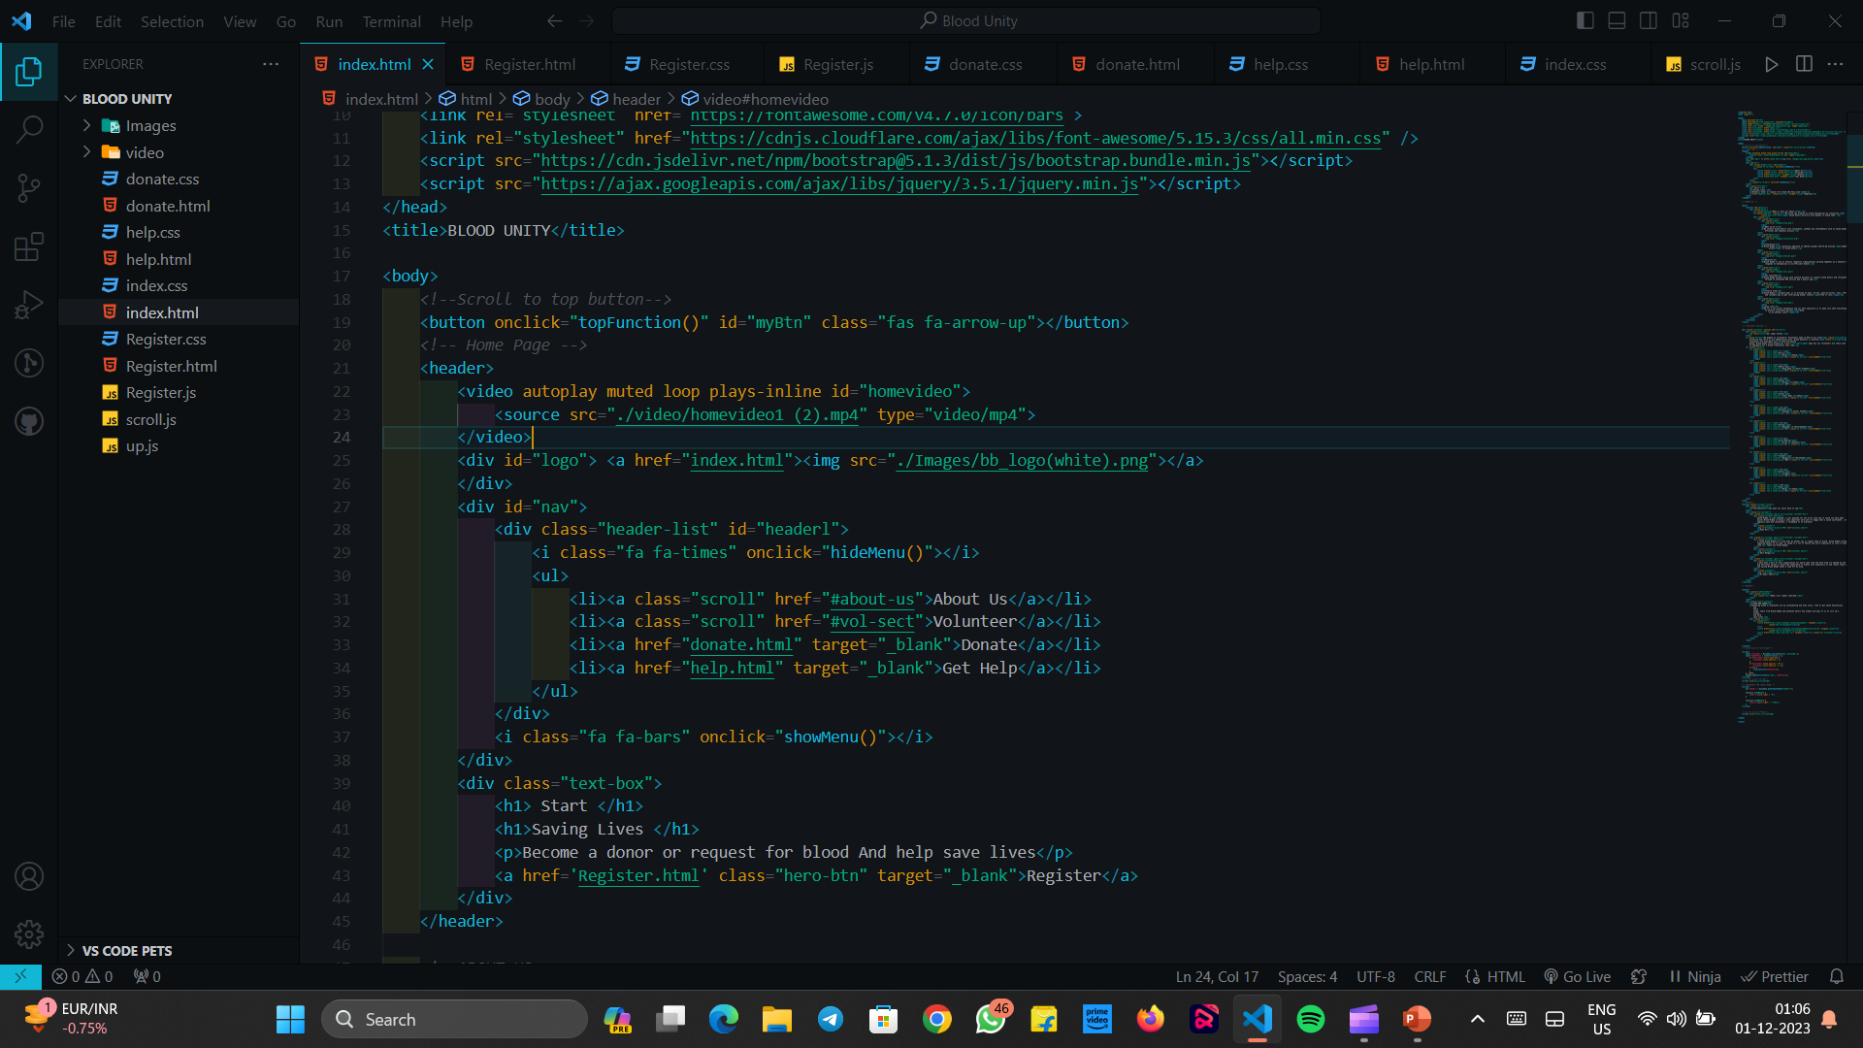
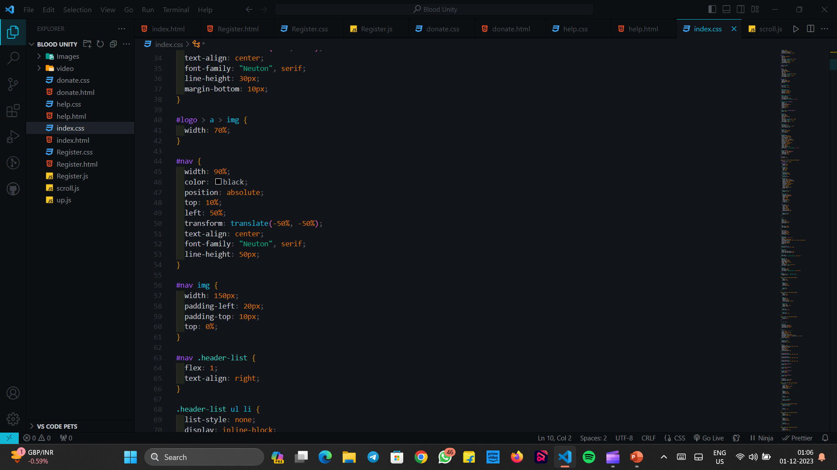
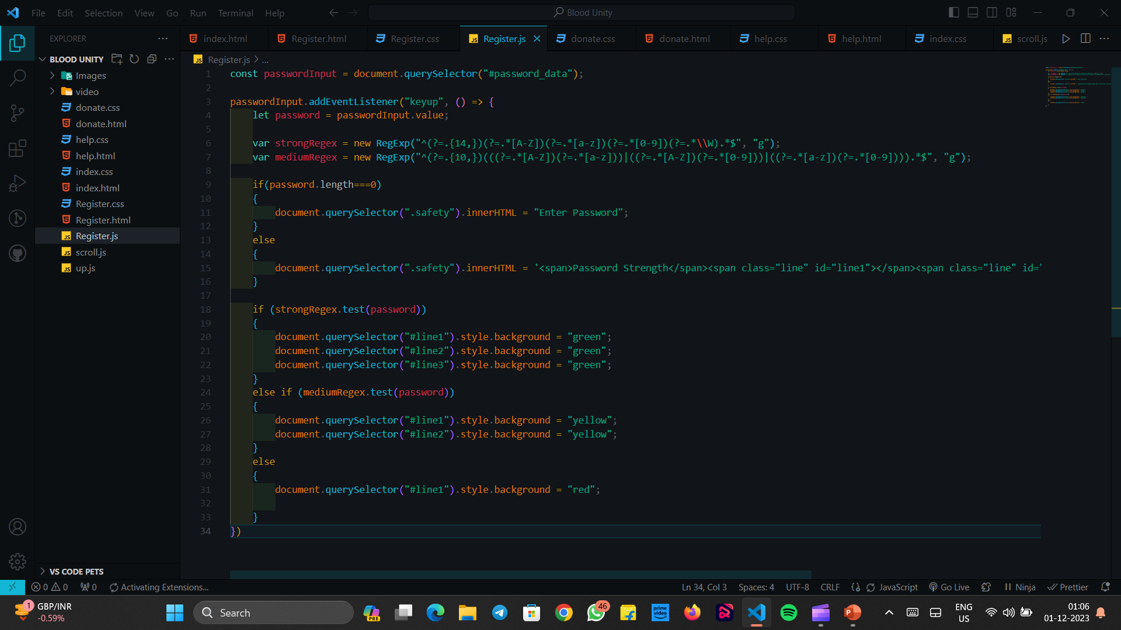

Slide 11
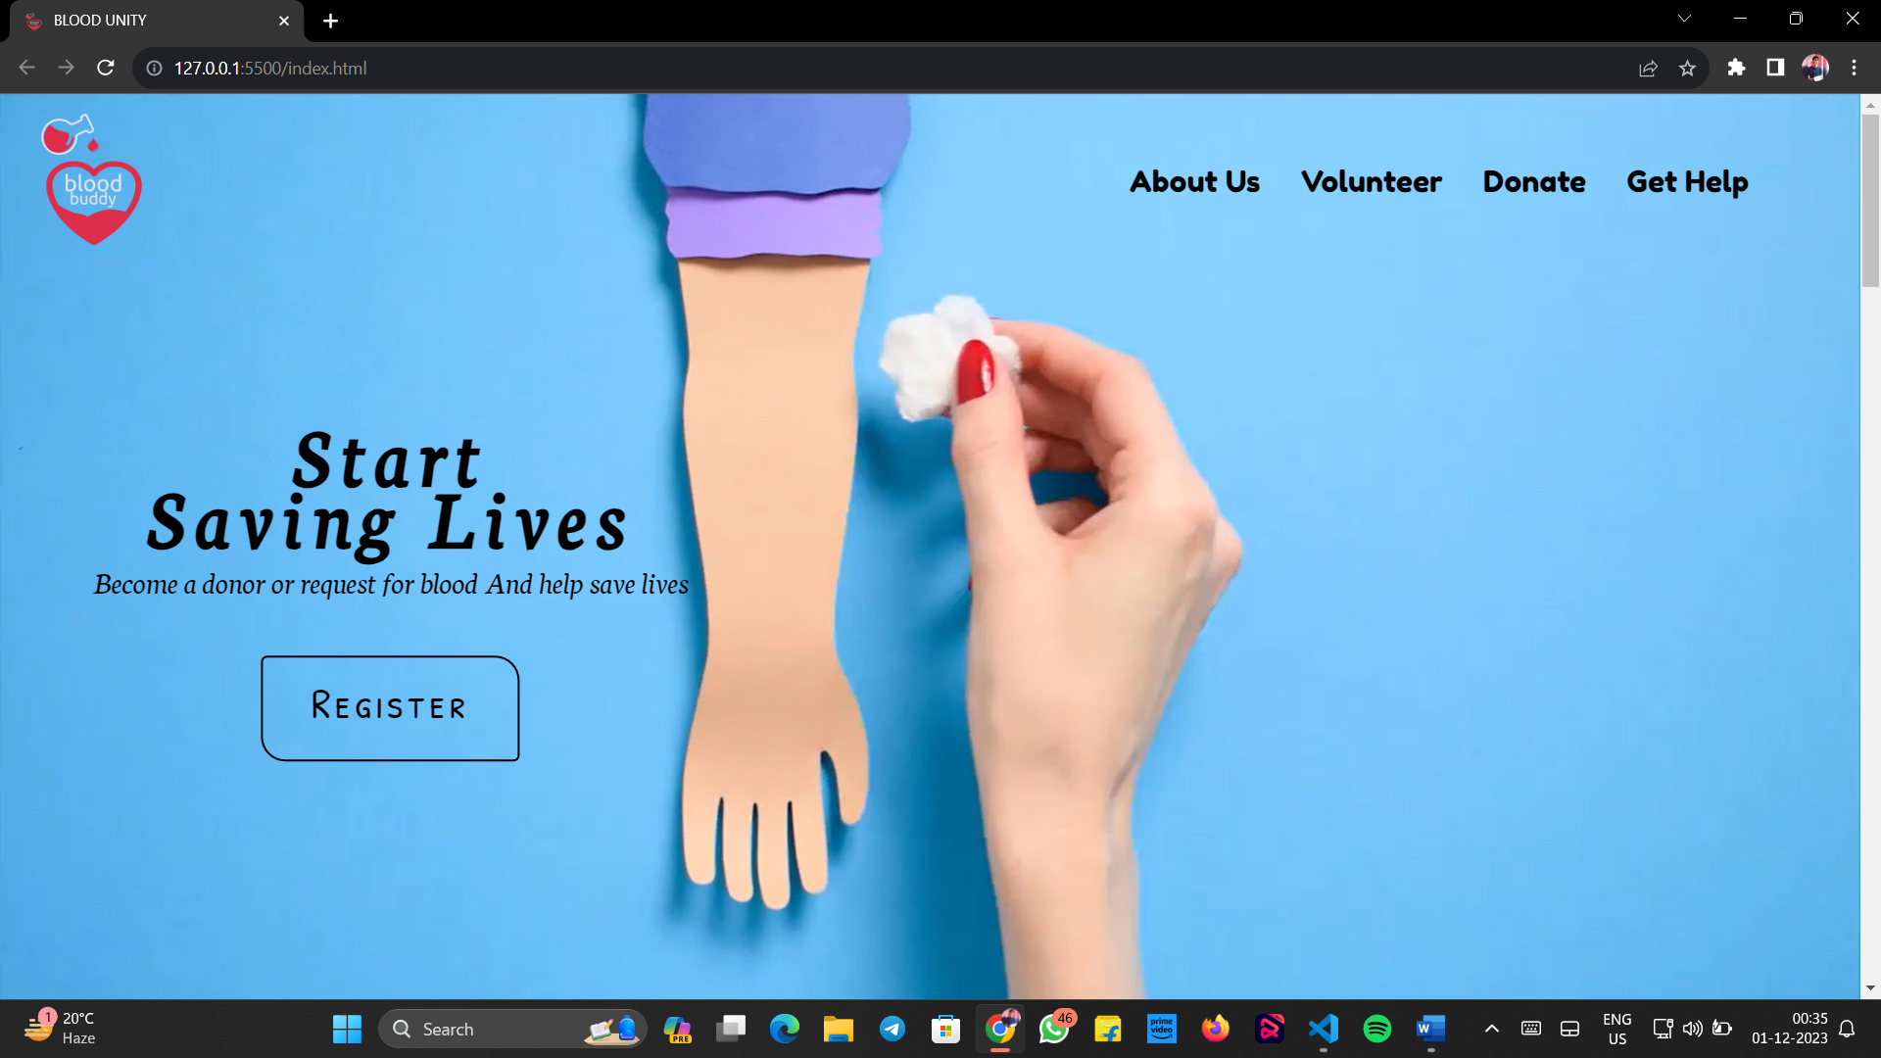

Slide 12
Implementation
1. Frontend Development:
Technologies: Use HTML, CSS, and React for creating an intuitive and responsive user interface.
Components: Develop pages for user registration, authentication, donor search, appointment scheduling, and user profiles.
User Authentication: Implement secure authentication mechanisms using JWT (JSON Web Tokens)
2. Backend Development:
Technologies: Use Node.js with Express.js for the backend server.
Routes and Controllers: Create routes and controllers to handle user registration, authentication, donor matching, and appointment scheduling.
Database Integration: Connect to Mongo DB to store and retrieve user data, appointments, and other relevant information.
Authentication Middleware: Implement middleware for secure user authentication.

Slide 13
Features
Develop a user-friendly and responsive website accessible from various devices, including desktops, tablets, and smartphones.
Create and share informative content about the benefits of blood donation, the donation process, and community impact.
Participate in online forums and communities related to health, wellness, and community service

Slide 14
Result Analysis
User Engagement:
Evaluate website traffic, user activity, and engagement metrics.
Analyze social media interactions, likes, shares, and comments.
Matching Success:
Assess the efficiency of the donor-recipient matching algorithm.
Review the success rate in connecting donors with recipients.
Appointment Scheduling:
Analyze the number of appointments scheduled by donors.
Assess user satisfaction with the appointment scheduling process.
User Feedback and Ratings:
Review user feedback to identify common themes or issues.
Analyze trends in user ratings for donors and the overall platform.

Slide 15
Challenges Faced
Difficulty in attracting and retaining users
Analyze user feedback and identify pain points.
Implement targeted marketing campaigns to increase awareness.
Inefficiencies in the donor-recipient matching algorithm.
Low user participation during urgent donation requests.
Challenges in raising funds to support the platform

Slide 16
Conclusion
Blood Unity turned one! It's like a superhero for blood donation, making things clear, organized, and trustworthy. It helps donors easily give blood, matches them with those who need it, and keeps everything honest. Looking forward to more cool stuff and helping even more people together!

Slide 17
Acknowledgments
The success of Blood Unity would not have been possible without the dedication of the development team, the support of the blood donation community, and the collaboration with healthcare professionals.

Slide 18
References
Wikipedia.com
https://w3school.com/
Google
MDN

